Slide 1
Project Application Development
Bindu, Assem, Justice, Joud and Justin

Slide 2
Introduction
General Information
Mathematical Models
UML
Application
Summary and Conclusion

Slide 3
General Information
Project Plan
Meetings
Agendas and Minutes

Slide 4
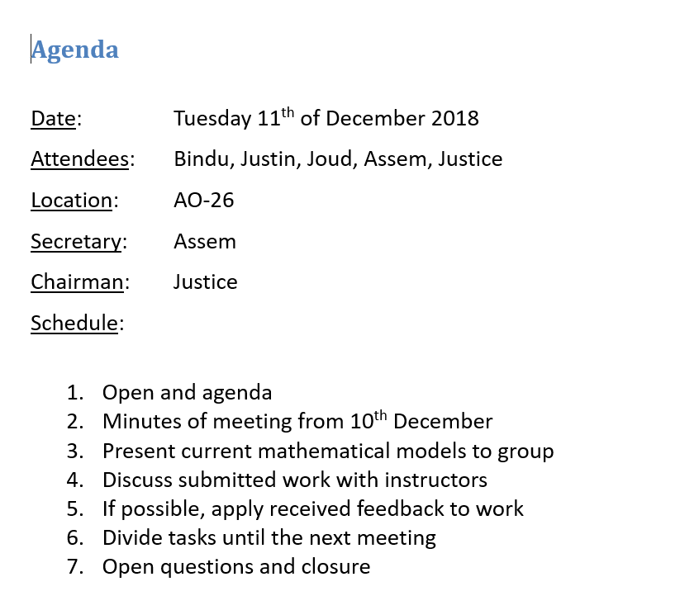

Slide 5
What is the best ethically acceptable measure which can be taken to improve the ecological balance in the Oostvaardersplassen?
Needs of the client
Available models
Variables to be used
Models simple enough
Application

Slide 6
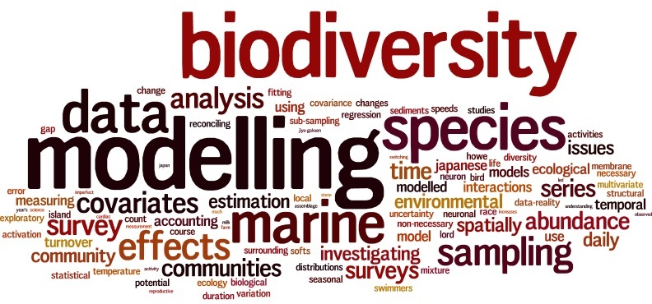
Why Modeling ?

Slide 7
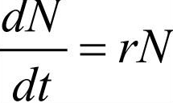
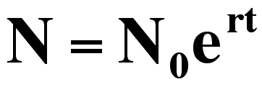
Mathematical Models
The math model for exponential growth :

Slide 8
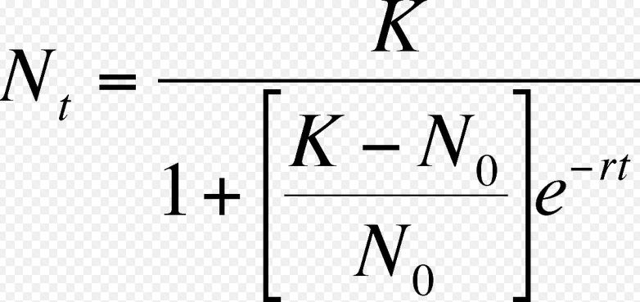
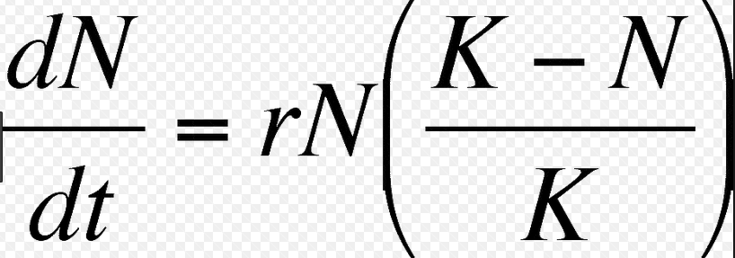
The logistic model growth:

Slide 9
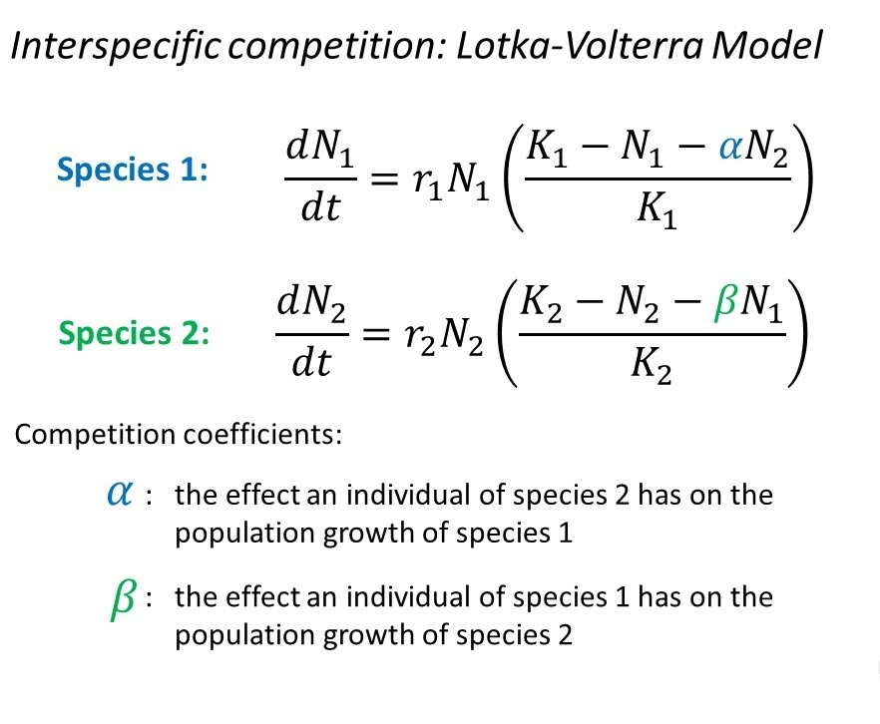
Interaction between large herbivores (Cattle and horses)

Slide 10
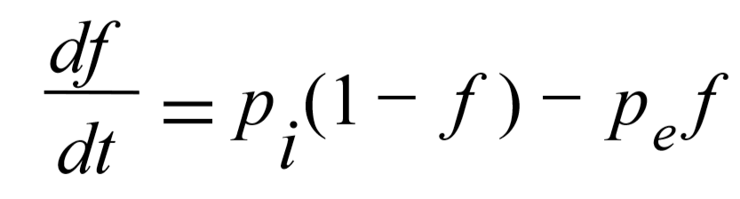
Model with migration effect (Simple metapopulation growth rate)

Slide 11
UML
Sample data blah blah

Slide 12
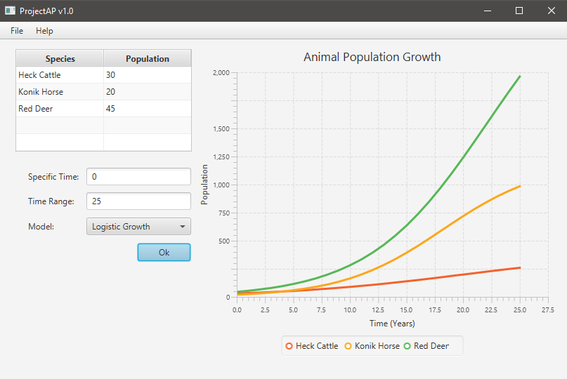
Application

Slide 13
Summary and Conclusion
Answer to question still unknown
Models not yet advanced
Application is structured
Questions?

